Slide 1

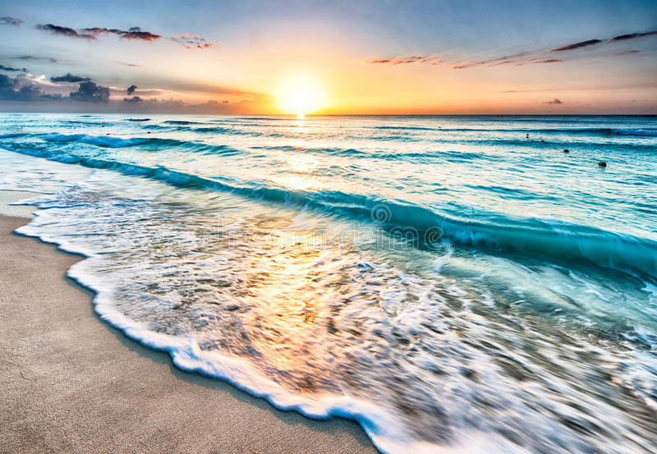
Smart Beach by Bruce County
for Sanjeev Kumar
Sanjeev Kumar - Professor
Brunilda Xhaferllari – Project Manager
Rich Freeman – Faculty Mentor
AI Team:
Janvi Patel
Fangji Chen
Scaria Ouseph Kurian
Date: 29-03-2023
Notes:
Image: 12019 (2016) Ocean waves crashing on shore during daytime https://pixabay.com/photos/beach-sea-sunset-sun-sunlight-1751455/

Slide 2

Additional activities since the last report
Work:
Annotating all the images of the data provided last week.
Working on documentation of the project.
Training models on new data to get a final accuracy.
Notes:
Padrinan, Miguel (n.d.). Email blocks on Gray Surface. Accessed on January 16th, 2023 from https://www.pexels.com/photo/email-blocks-on-gray-surface-1591062/

Slide 3
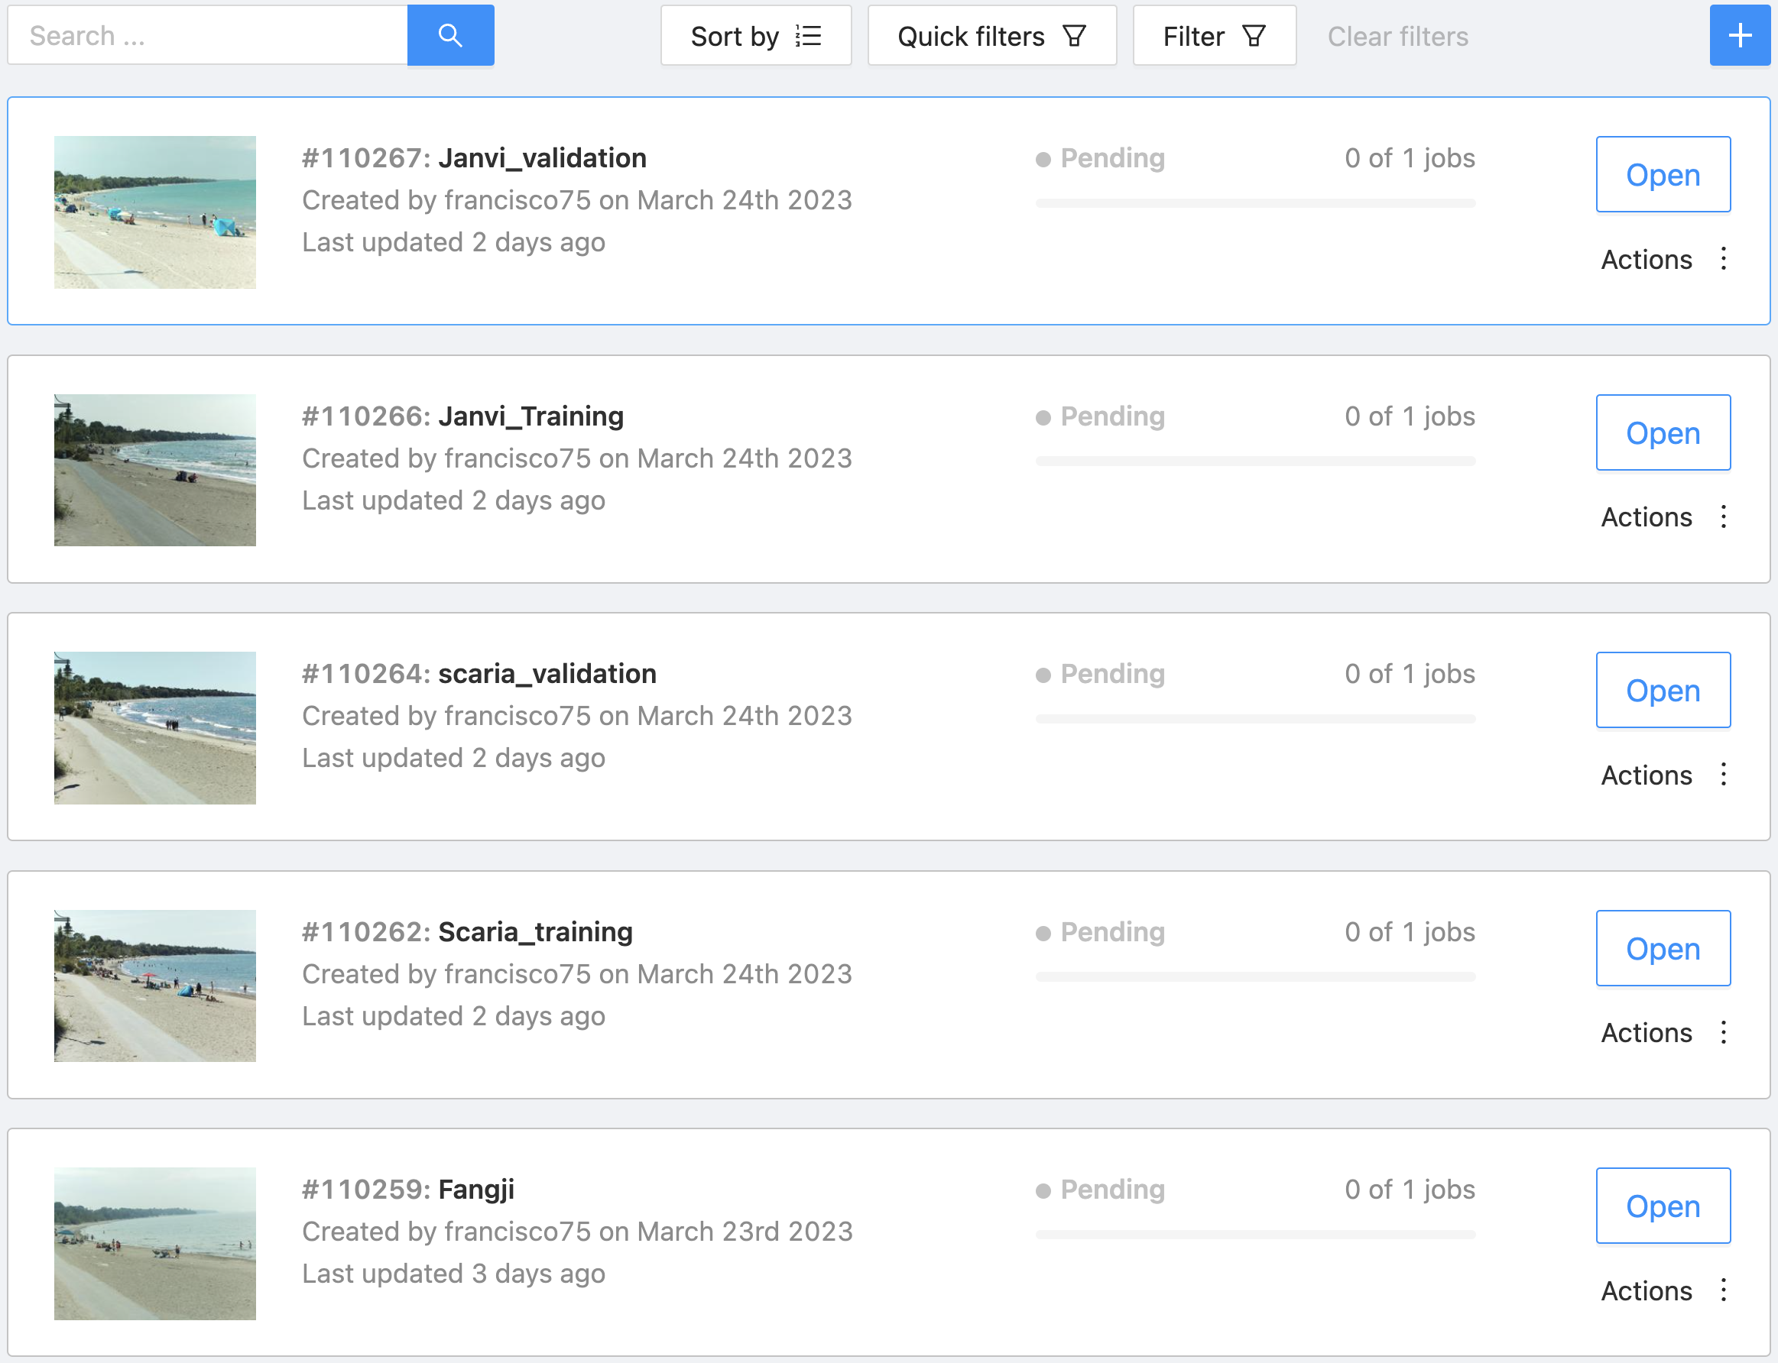
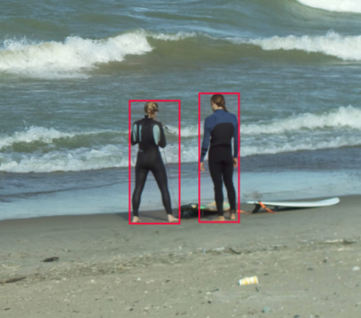
We have divided the tasks into parts to work faster.
As shown above.

Slide 4
Architecture updates

Slide 5
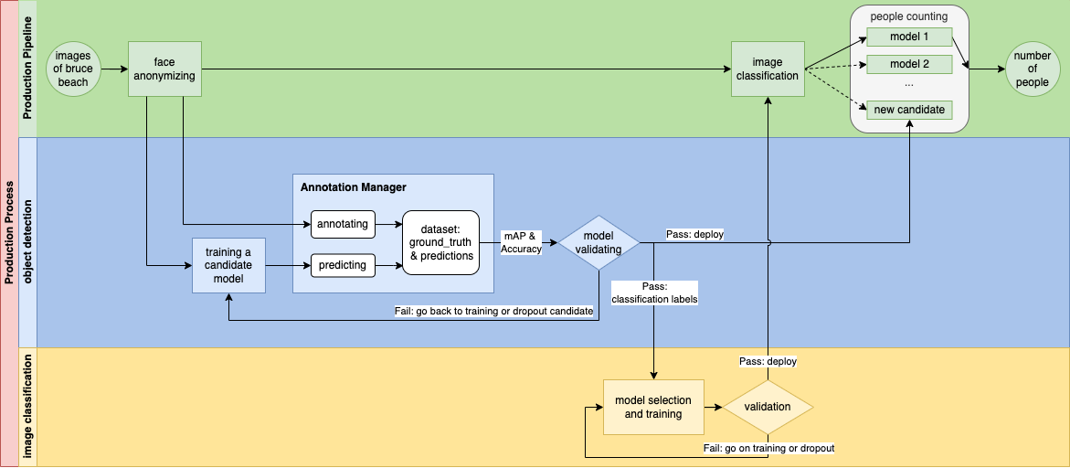

Slide 6
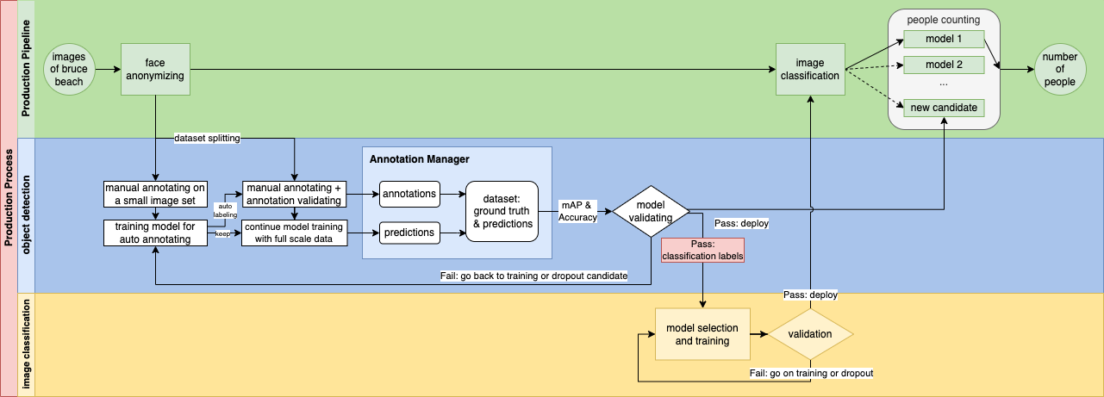

Slide 7
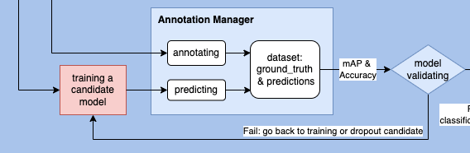
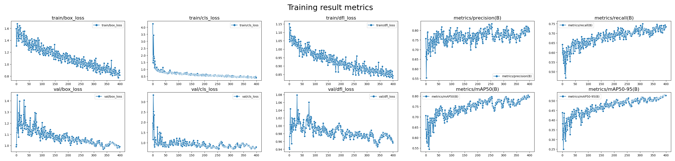
Compare the previous 35 training images, now with over 25 hours work of annotating, we got a training dataset with 158 images and a validation dataset with 73 images.
Over 12k manual annotated bounding boxes.
The training results are visualized as the image shows above.

Slide 8
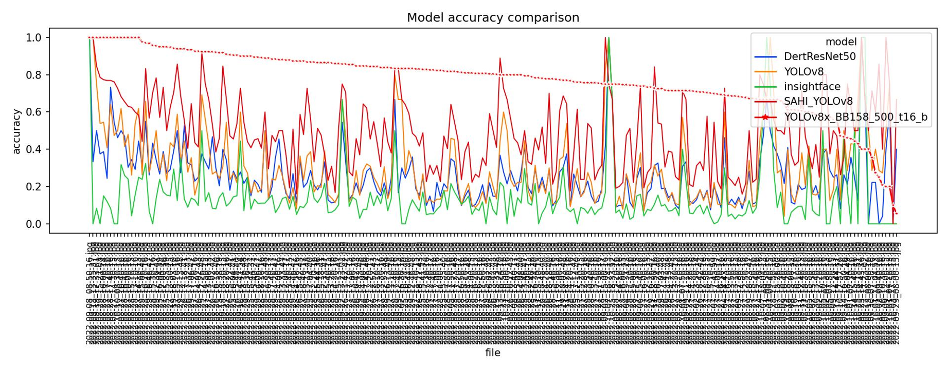
In most of the case, the latest model shows the best accuracy than all the other candidates.
Some bad case are found in this plot due to the reason of the lack of training data: the model needs a wider range of training cases to learn what are the real patterns of people.

Slide 9
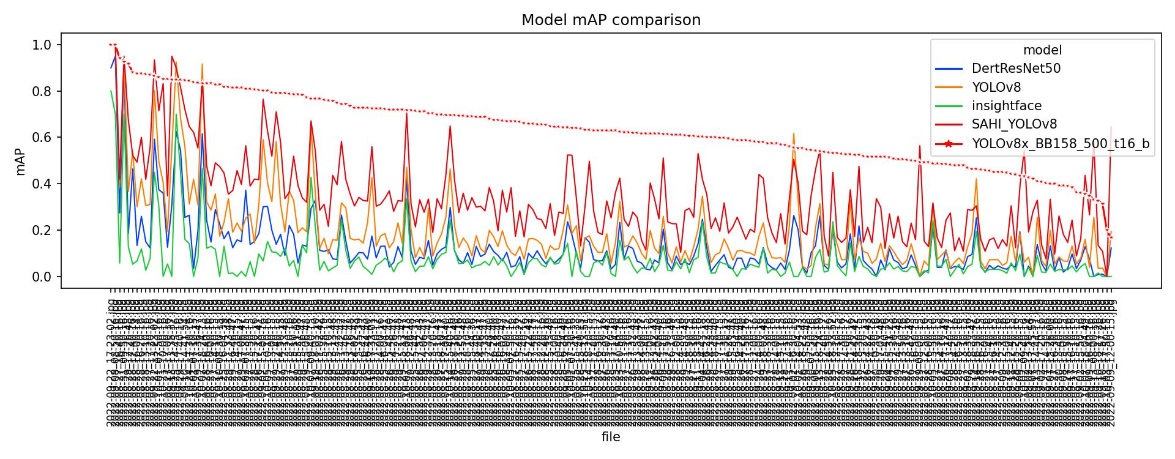
The same issue can be seen in this mAP score metric plot

Slide 10
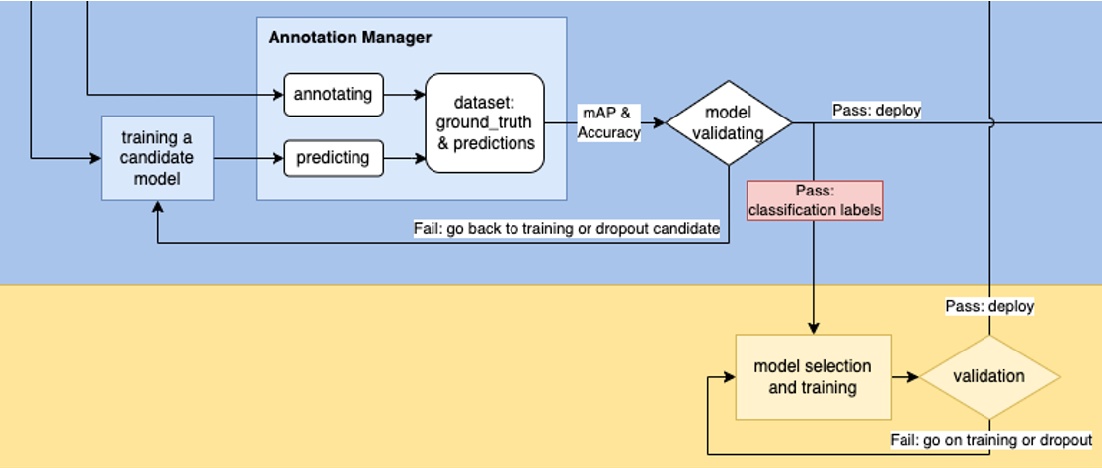
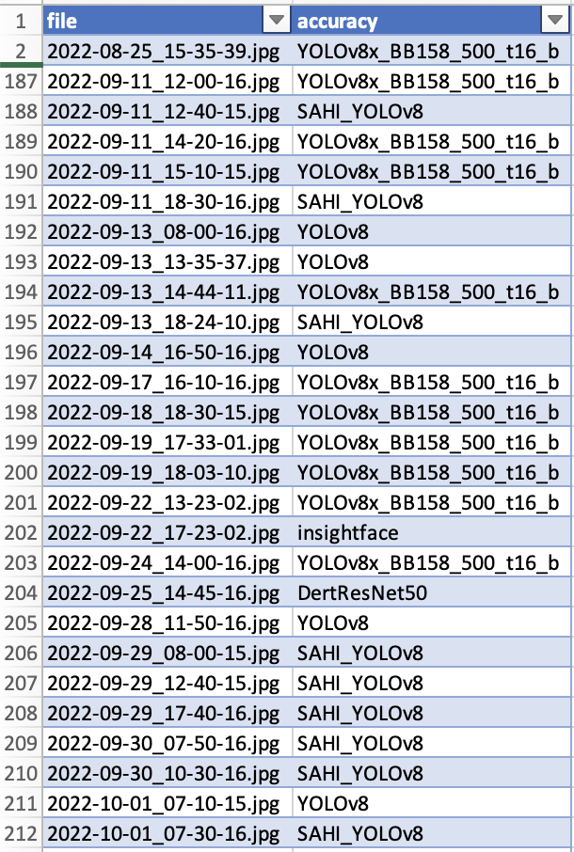
Same labels are hidden on the top of this classification ground truth table because the accuracy suggests the same result of YOLOv8x_BB150_500_t16_b.
The new classification model and the people counting model are needed to deploy at the same time to meet a match of each other.

Slide 11
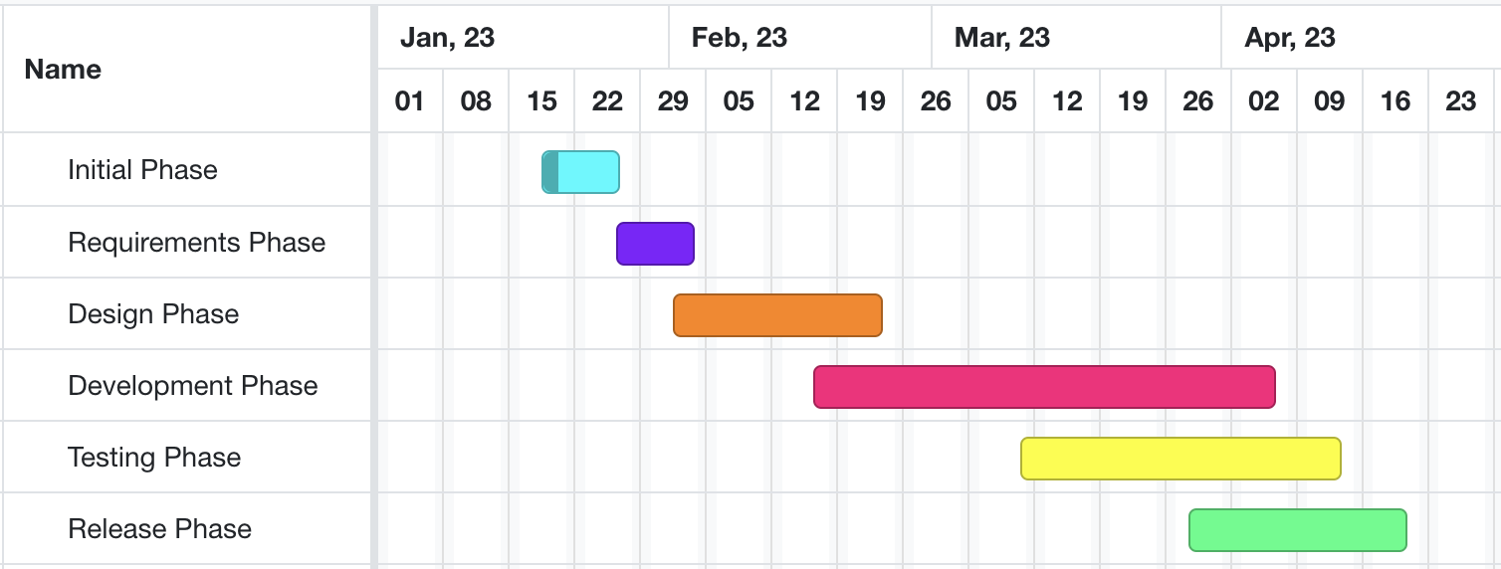
Developing and testing models on beach data
High-level GANTT Chart

Slide 12
Activities to be Completed before Next report:
Final model testing.
Project submission.
Notes:
Olexa, Peter (n.d.) A Person Making a Schedule. Accessed on January 18th, 2023 from https://www.pexels.com/photo/a-person-making-a-schedule-14299948/

Slide 13
Thank you!
Questions?
Notes:
Image: Leloo, The first (2022) https://www.pexels.com/photo/question-marks-on-paper-crafts-5428833/

